Slide 1


Department of Computational Science
Open World Car Simulator
Presented By | : BCA20007
Course Code | : BCAC602
Course Name | : Project

Slide 2
Department of Computational Science
Agenda
Introduction
Game Engine
Utility of the Project
Mechanism
Pros & Cons
Future's scope
References

Slide 3
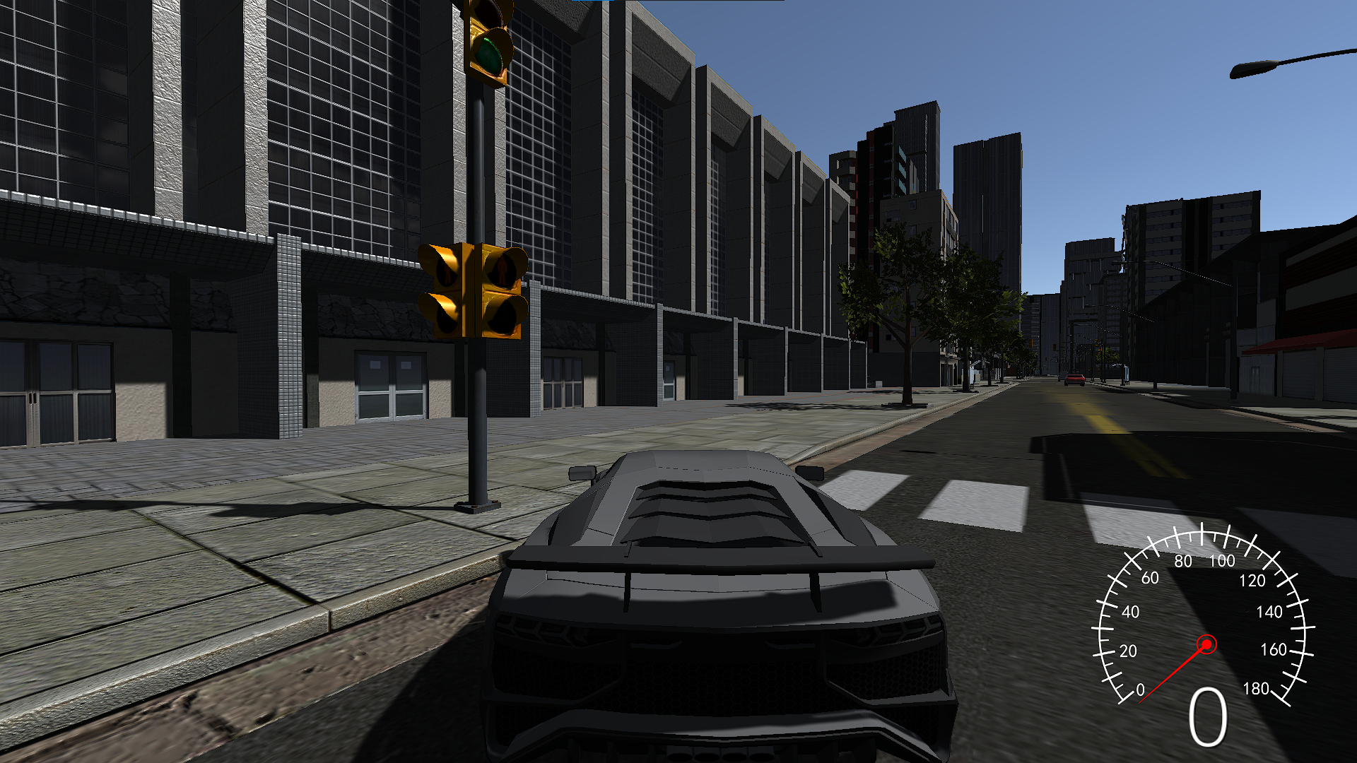
Department of Computational Science
Introduction
Driving simulators are used to conduct experiments on for example driver behavior, road design, and vehicle characteristics. The results of the experiments often depend on the traffic conditions

Slide 4
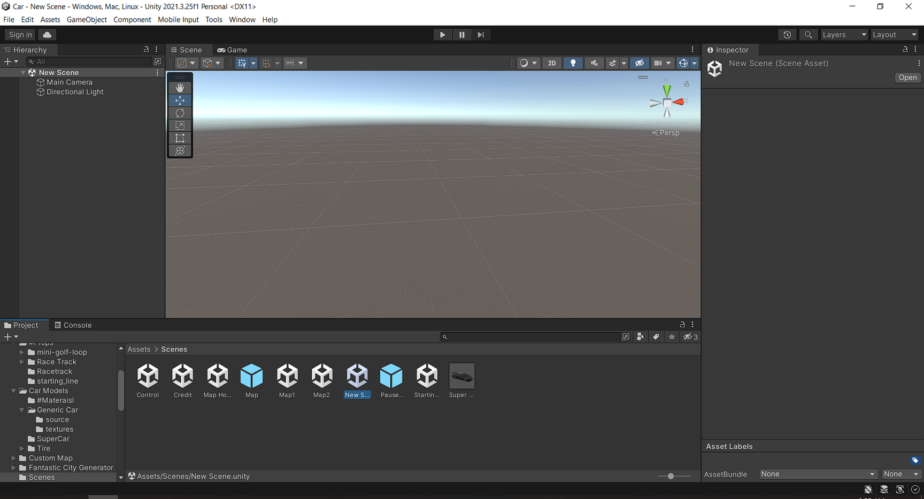

Department of Computational Science
Game Engine
Both 3D and 2D games and interactive content.
The most popular platforms are Android, PC, and iOS systems

Slide 5
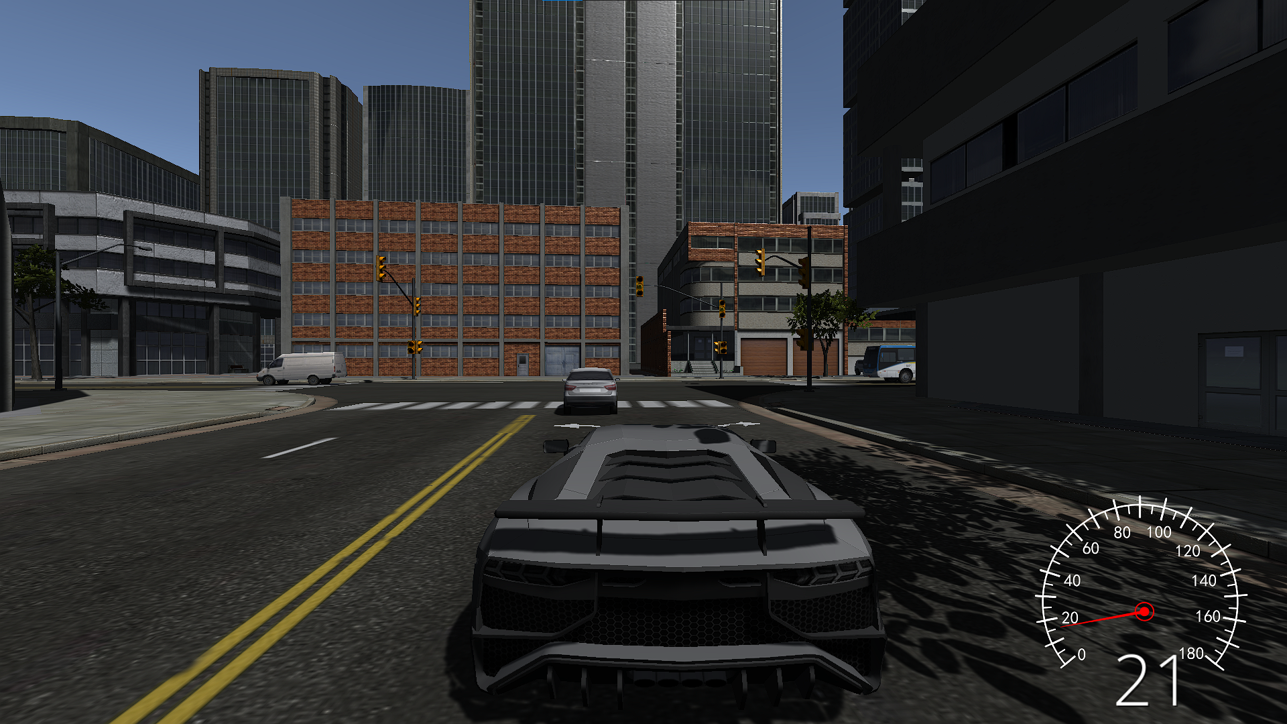
Department of Computational Science
Utility of The Project
This application will be used by users to get full refreshment at the different physical time.
Simulation games are a genre of games that are designed to mimic activities you’d see in the real world.

Slide 6
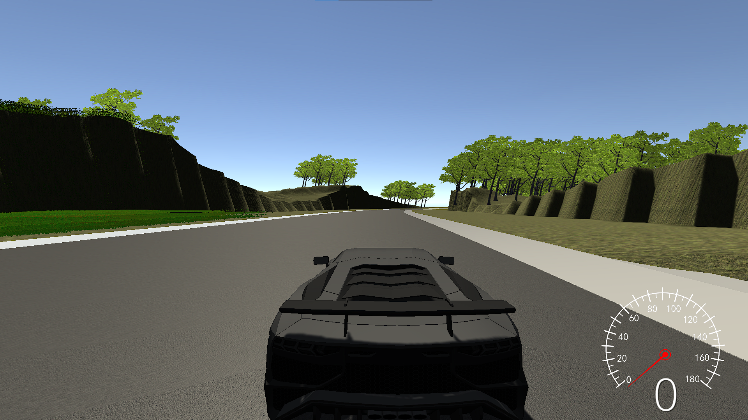
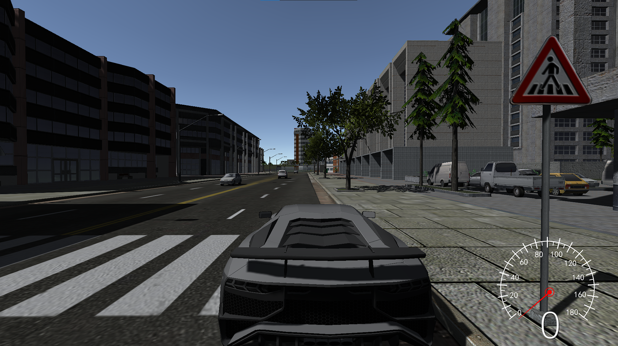
Department of Computational Science
Mechanism

Slide 7
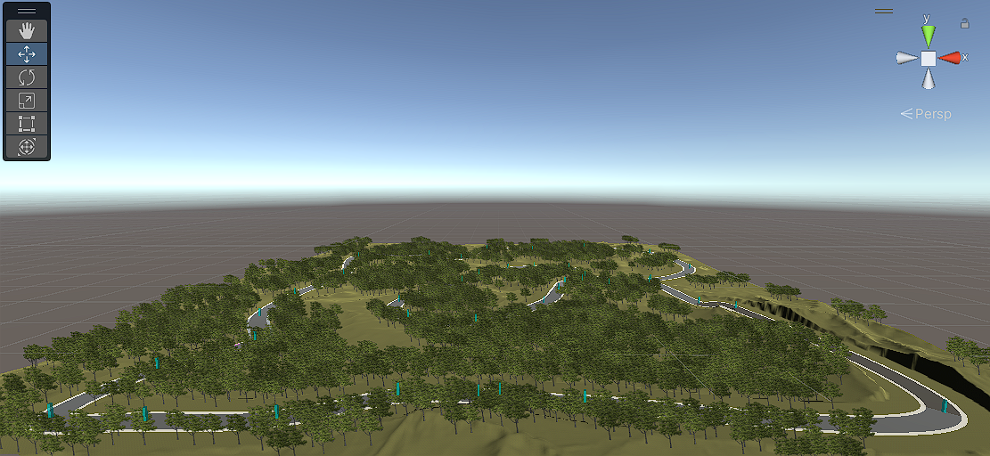
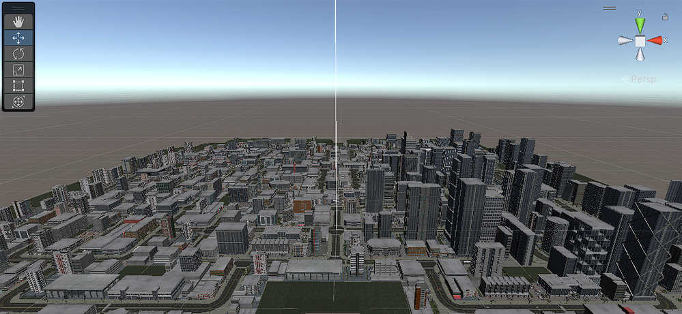
Department of Computational Science

Slide 8
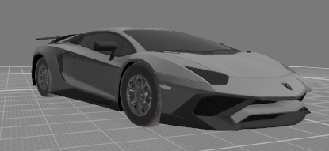
Department of Computational Science

Slide 9

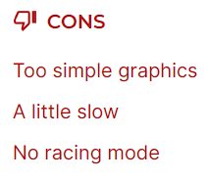
Department of Computational Science
Pros & Cons

Slide 10
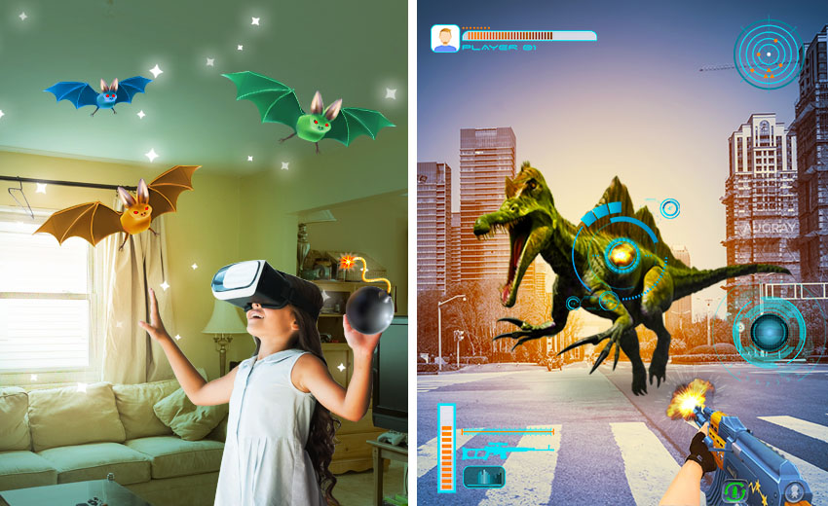
Department of Computational Science
Future Scope
To improve this project to compete other games like us and bring a evolution in gaming industry.

Slide 11


Department of Computational Science
References
Unity Asset store
Brackeys YouTube Channel

Slide 12
Department of Computational Science
Thank You

